Slide 1

C# NINJITSU
Notes:
Creative Commons Attribution: http://www.flickr.com/photos/grrphoto/152833988/

Slide 2

Chris Eargle
C# MVP

Slide 3
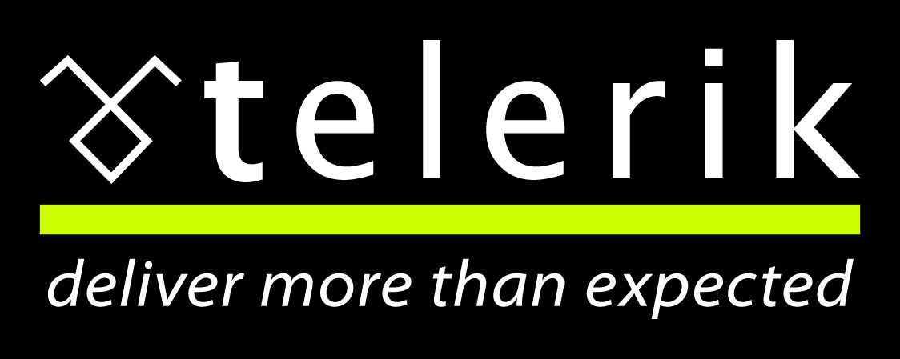

Slide 4


INETA.ORG
Be a Speaker

Slide 5
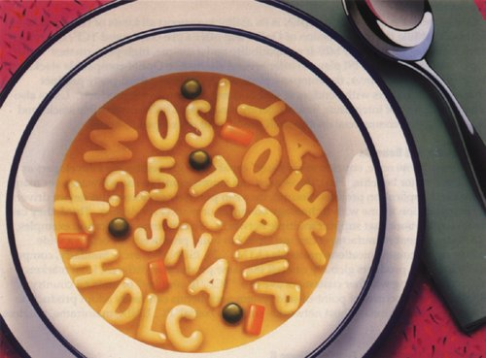

Slide 6
Website: kodefuguru.com
Email: kodefuguru@live.com
Twitter: @kodefuguru
Facebook: facebook.com/kodefuguru

Slide 7

Notes:
Image by Wes Benson

Slide 8


Slide 9
kodefu.codeplex.com

Slide 10

Readable
Notes:
Creative Commons Attribution: http://www.flickr.com/photos/bracketing_life/4215944196/

Slide 11

Maintainable
Notes:
Creative Commons Attribution: http://www.flickr.com/photos/bexross/2417965928/

Slide 12

Most General Interface
Notes:
You may have heard of the principle, favor interfaces over implementation, but many people take quite literally in .NET and simply add an ‘I’ to their declarations. This is a mistake, they should be using the exact interface necessary for the functionality required

Slide 13

Most General Interface
Interface
Hierarchy
Notes:
When there is an interface hierarchy, it is essential to use the most general interface.

Slide 14
Most General Interface
IEnumerable<T>
Notes:
This is typically seen with lists and collections. The generic list implements List<T>, which requires Collection<T> and IEnumerable<T>. In many cases, a developer learns of the favor an interface over implementation principle and immediately uses Ilist<T> when the correct interface to use is IEnumerable<T>.

Slide 15
Most General Interface
LINQ
Notes:
If you’re using C# 3 and up, LINQ to Objects allows any implementation of IEnumerable<T> to be queried, negating the necessity of implementing specific collection classes and making this interface infinitely more useful.

Slide 16
Most General Interface
DEMO

Slide 17

Favor Fluency
Notes:
The term Fluent Interface was coined by Eric Evans in 2005 to describe a style of programming in which the API is more readable and flows. It is similar to having an internal DSL.

Slide 18

Favor Fluency
Method
Chaining
Notes:
The key to creating a fluent interface is the use of method chaining, which the return type of one method allows one to immediately call another method.

Slide 19
Favor Fluency
Left
To
Right
Notes:
I look beyond the chaining by returning the same type, and consider it fluent when I continue with my chain of thought. We read and write left to right, we should code the same way. As long as it is apparent from the semantics of the code what is happening, I consider it a good thing.

Slide 20
Favor Fluency
context
Notes:
The returning context is important. Oftentimes, a fluent interface is returning the object or interface the method is acting upon. This allows one to chain indefinitely. When a void method is encountered, the chain is terminated.

Slide 21
Favor Fluency
out
&
ref
Notes:
Avoid the out and ref keywords. They are anachronisms of C and inhibit the creation of a fluent interface.

Slide 22
Favor Fluency
Complex
Types
Notes:
Out and ref parameters indicate a need to return more than one value, so consider refactoring the method to return a complex type. By returning a complex type, oftentimes the object itself, you can continue building it up. If you are working with pure functions or immutable types, these new objects have the benefit of not creating side effects.

Slide 23
Favor Fluency
LINQ
Notes:
A perfect representation of a fluent interface in the .NET framework is LINQ, also known as Language Integrated Query. If you use the extension method version of linq, each method can be chained off another until a terminating method is encountered.

Slide 24
Favor Fluency
DEMO

Slide 25

Avoid Side Effects
Notes:
We write business applications, so side affects are unavoidable. This is truly avoid unnecessary side effects, and by extension, avoid unintended consequences.

Slide 26

Avoid Side Effects
State
Notes:
A side effect changes the state of your object, the state of your software, or the state of the system. Examples of side effects are mutating an object or writing to the screen.

Slide 27
Avoid Side Effects
Purity
Notes:
A pure function is one that returns the same results given the same arguments; without producing side effects. I believe there are different levels of pure methods. The most pure is the one I just defined. A method that modifies the object it belongs to is a little less pure. One that modifies objects passed into it is less pure than that, and the worst kind of methods are the kind that modify the state of objects that do not pertain to the method’s parameters or its object.

Slide 28
Avoid Side Effects
Encapsulation
Notes:
Recall the first demo. The list was directly exposed. This violated encapsulation as the container object did not have control over its containee. Lists are a common cause of unintended consequences, and I will demonstrate this shortly.

Slide 29
Avoid Side Effects
DEMO

Slide 30

Favor Declarative Code

Slide 31

Favor Declarative Code
What
not
How
Notes:
Writing declarative code is similar to how you write method names: you want to describe what you are doing not how you are doing it. For example, a method named GetOrders is correct, whereas GetOrderFromXml exposes implementation details.

Slide 32
Favor Declarative Code
Initializers
Notes:
Initializers came out in C# 3.0, and some may not consider them necessarily declarative. I think they are great for laying out an object graph when

Slide 33
Favor Declarative Code
?

Slide 34
Favor Declarative Code
??

Slide 35
Favor Declarative Code
LINQ

Slide 36
Favor Declarative Code
DEMO

Slide 37

Strive for Functional Cohesion

Slide 38

Strive for Functional Cohesion
Strive
for
High Cohesion
Notes:
The principle many people hear is called strive for high cohesion. This is a great principle, but provides little guidance without research.

Slide 39
Strive for Functional Cohesion
Single Responsibility Principle
Notes:
Bob Martin introduced the Single Responsibility Principle, which is that a class should have one reason to change. This seems to provide better guidance and directs us towards the highest level of cohesion known as Functional Cohesion.

Slide 40
Strive for Functional Cohesion
Helper
Classes
Notes:
The problem is that we have classes that can’t be modified, or we need to program functionality for interfaces. We end up creating static helper classes (logical cohesion at best) to provide the missing functionality.

Slide 41
Strive for Functional Cohesion
Extension
Methods
Notes:
In C# 3, we got extension methods. This adheres to the open-closed principle that classes should be open to extension but closed to modification. We can now add the functionality where it belongs, making the class (or interface!) a cohesive whole.

Slide 42
Strive for Functional Cohesion
DEMO

Slide 43

Extension Over Inheritance
Notes:
Creative Commons Attribution: http://www.flickr.com/photos/16691890@N05/2301038688/

Slide 44

Extension Over Inheritance
Extension Methods

Slide 45
Extension Over Inheritance
Interfaces

Slide 46
Extension Over Inheritance
Lego
Classes

Slide 47
Extension Over Inheritance
DEMO

Slide 48
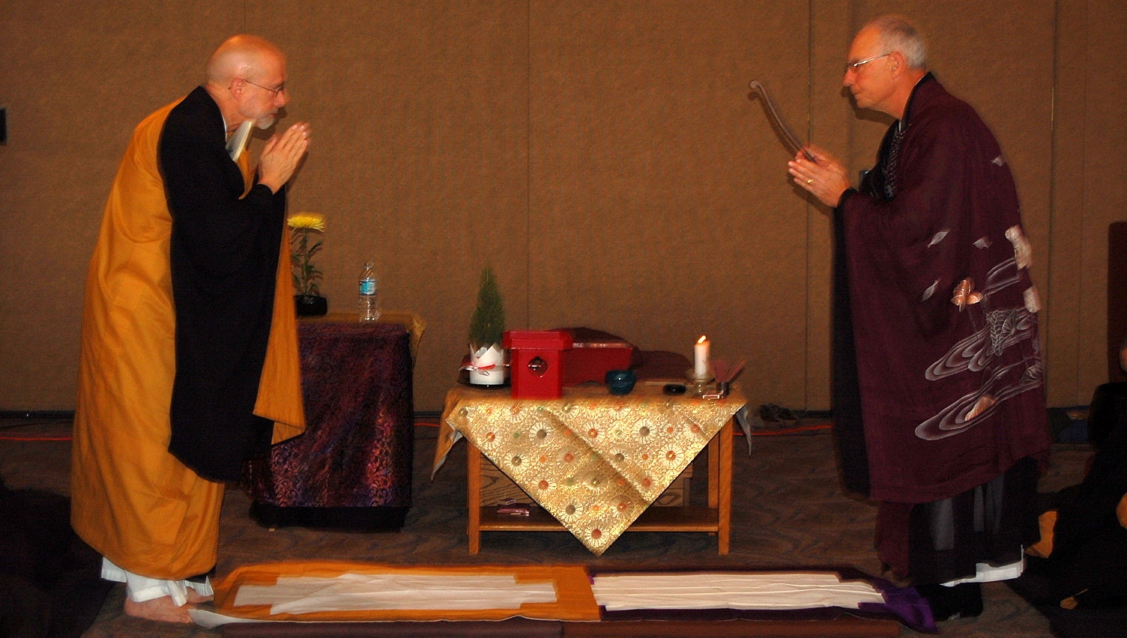
Thank You
Notes:
Creative Commons Attribution: http://www.flickr.com/photos/kanzeon_zen_center/322184248/

